Slide 1
Efficient Deep Learning
Demonstrating how CNNs can be optimized for edge device deployment
By: Shane McCammon

Slide 2
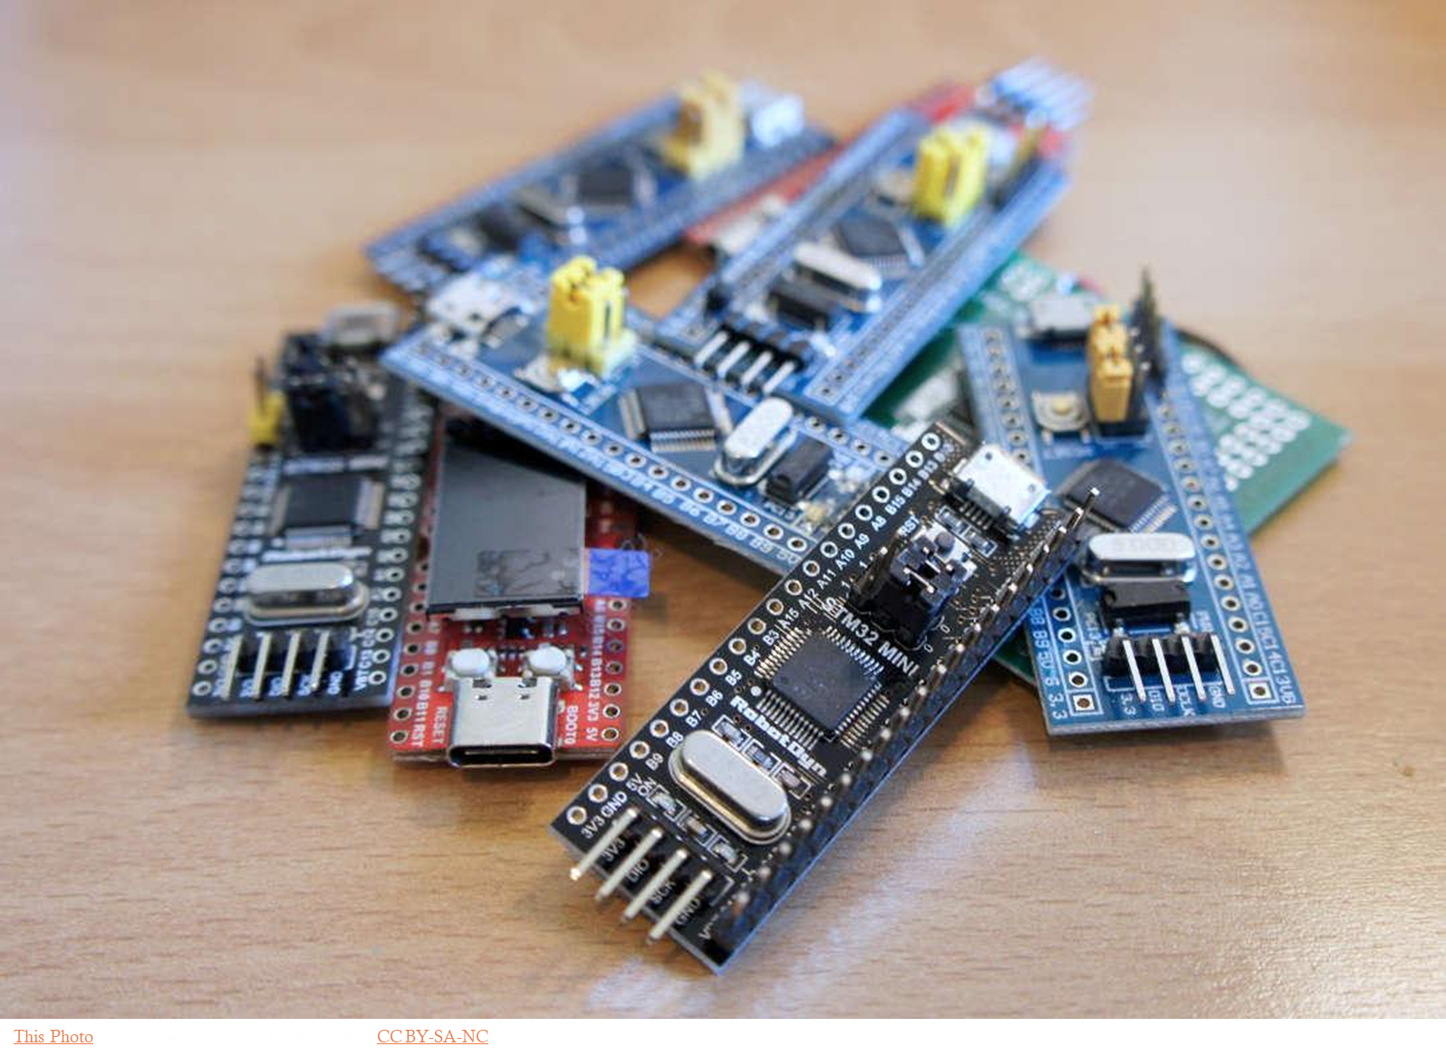
Motivation
Edge devices have limited flash, RAM, and CPU resources
Standard FP32 CNNs are overkill and can be slow or too large for microcontrollers
How can we compress the CNN without sacrificing accuracy?

Slide 3
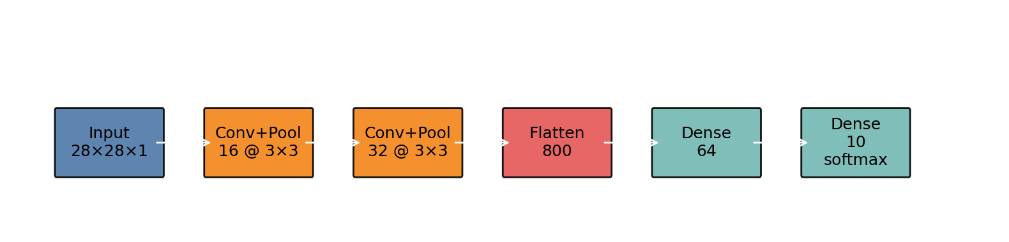
Baseline CNN on MNIST
Architecture
Conv(3x3, 16) -> MaxPool
Conv(3x3, 32) -> MaxPool
Dense 64 -> Dense 10
Parameters: 56,714
Saved model size (FP32 .h5): 708.6 kB
Test Accuracy: 99.1%
Latency: 84.6 ms / inference (CPU)

Slide 4
Optimization Techniques
Pruning (~50%)
Remove small-magnitude weights, half become zero, resulting model smaller
Post-Training Quantization (PTQ, INT8)
Convert trained FP32 weights/activations to 8-bit integers without retraining, decreasing memory usage and latency
Quantization-Aware Training (QAT, INT8)
Simulate quantization during training, recovers or improves accuracy compared to PTQ

Slide 5
Model Results & Comparison
Model | Size (KB) | Acc (%) | Latency (ms) | Sparsity (%)
Baseline FP32 | 708.6 | 99.10 | 84.59 | 0.0
PTQ INT8 | 60.7 | 99.06 | 0.18 | 0.0
QAT INT8 | 61.1 | 99.20 | 0.25 | 0.0
Pruned FP32 | 249.8 | 99.07 | 48.66 | 49.9
Pruned+PTQ INT8 | 60.7 | 99.10 | 0.09 | 49.9
Pruned+QAT INT8 | 61.1 | 99.07 | 0.10 | 3.4

Slide 6
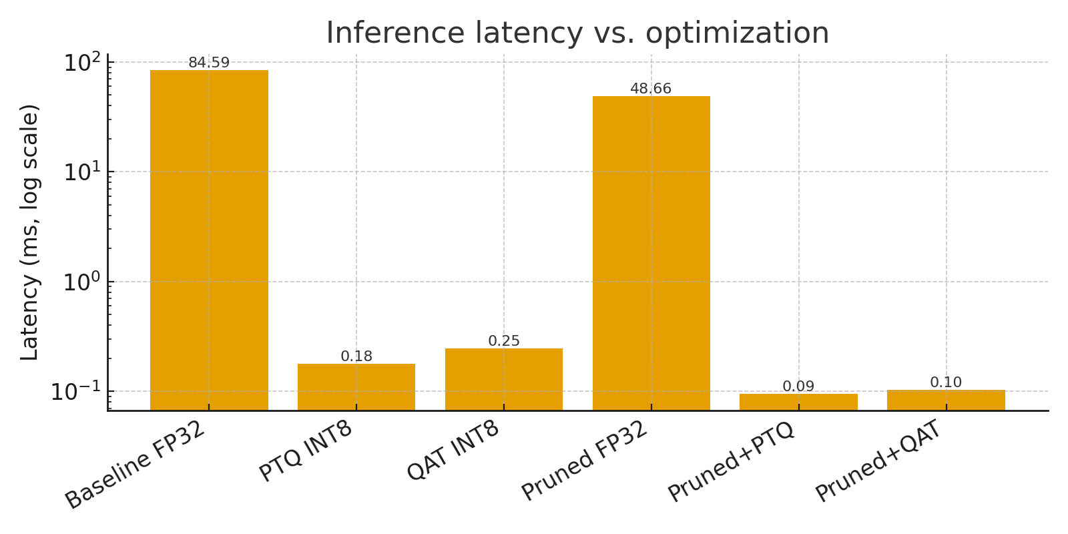
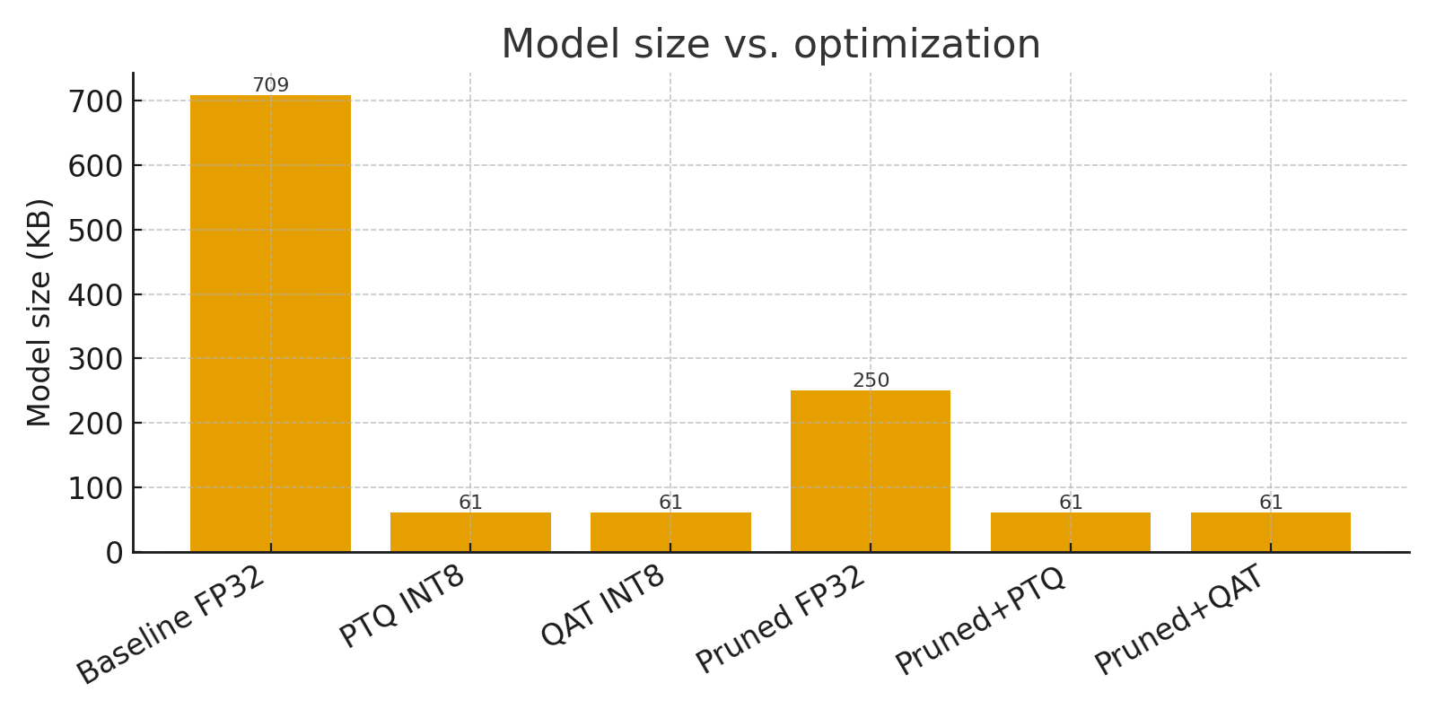
INT8 models ~12x smaller than baseline FP32
Pruned+PTQ INT8 model is 940x faster than baseline on CPU

Slide 7
Conclusions
Compression works
Pruning + INT8 quantization significantly reduces size and latency and performed the best
Accuracy remains robust
All models performed around ~99% accuracy
QAT slightly improves robustness to INT8 but not necessary for MNIST
Measuring latency carefully matters
Edge implications
Small models with INT8 inference are very practical for resource-constrained devices (60.7 kB)

Slide 8
Supplemental Material Overview
S1 – Architecture & Training details
S2 – Compression Methods (pruning, PTQ, QAT)
S3 – Latency Measurement Methodology
Github Repo:
https://github.com/ColoradoEmbeddedAI-Fall2025/final-project-sm

Slide 9
S1: Architecture & Training Details
Base CNN architecture:
Input: 28×28×1 MNIST image
Conv2D (16 filters, 3×3, ReLU) → MaxPool
(2×2)Conv2D (32 filters, 3×3, ReLU) → MaxPool
(2×2)Flatten → Dense(64, ReLU) → Dense(10, softmax)
Parameter Counts:
Conv2D(16): 160 params
Conv2D(32): 4,640 params
Dense(64): 51,264 params
Dense(10): 650 params
Total: 56,714 parameters
Dataset splits:
Training: 55,000 images
Validation: 5,000 images
Test: 10,000 images
Preprocessing
Grayscale → float32 → normalized to [0, 1]
Added channel dimension → (28, 28, 1)
Common Hyperparameters
Optimizer: Adam (default LR)
Loss: sparse_categorical_crossentropy
Batch size: 128
10 epochs per model

Slide 10
S2: Compression Methods
Pruning
Used tfmot.sparsity.keras.prune_low_magnitude with:
PolynomialDecay schedule:
initial_sparsity = 0.0
final_sparsity = 0.5 (50% target)
begin_step = 0
end_step = steps_per_epoch × 10
Used strip_pruning(pruned_model) to remove wrappers and get a standard sparse FP32 model.
Resulting sparsity:Pruned_FP32 & Pruned+PTQ_INT8: ~49.9% zeros
Pruned+QAT_INT8: ~3.4% zeros (QAT made some weights dense again)

Slide 11
S2: Continued
Post-Training Quantization (PTQ, INT8)
Applied to baseline and pruned FP32 models.
TFLite converter config:
converter.optimizations = [tf.lite.Optimize.DEFAULT]
converter.representative_dataset = representative_data_gen (500 images)
converter.target_spec.supported_ops = [TFLITE_BUILTINS_INT8]
converter.inference_input_type = tf.int8
converter.inference_output_type = tf.int8
Produces fully INT8 models (weights & activations) for TFLite.
Quantization-Aware Training (QAT, INT8)
Used tfmot.quantization.keras.quantize_model:
qat_model = quantize_model(baseline_model)
pruned_qat_model = quantize_model(pruned_model)
Converted QAT models to INT8 with the same TFLite PTQ pipeline.
QAT simulates quantization during training, slightly improving robustness to INT8.

Slide 12
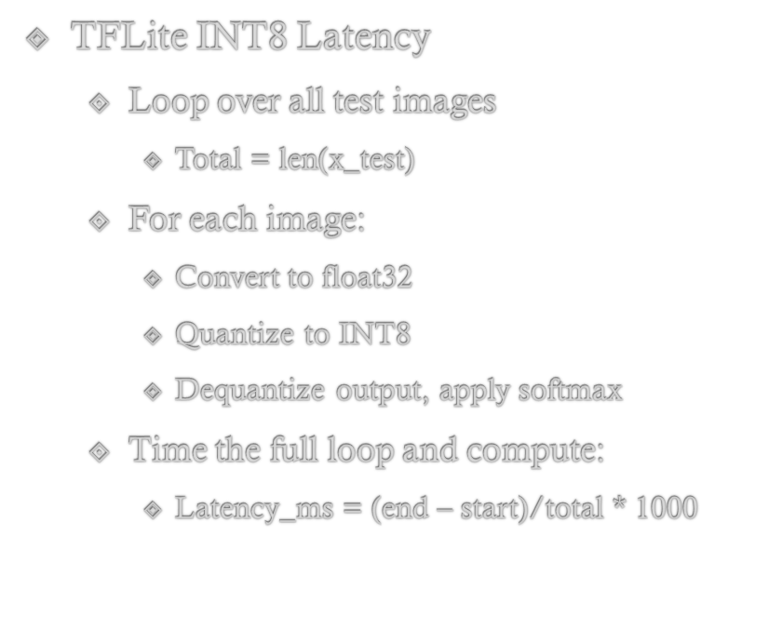
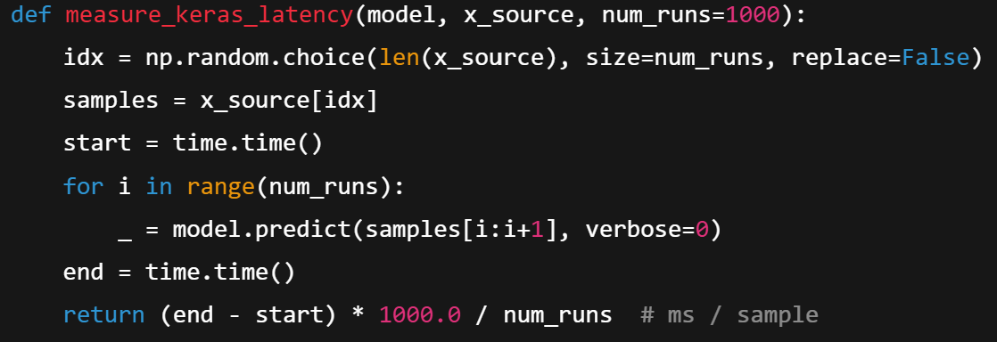
Latency Measurement
Keras FP32 Latency:
Measured host CPU
Batch size: 1
Average over 1000 random test images
Note: Latency is average clock time per inference on device CPU, it does include some Python and quantization overhead but fairly shows INT8 Tflite models are much faster than FP32 baseline

